Slide 1
Bayfield Electric Cooperative’s DER Policy
Cheq Bay Renewables

Slide 2
Perspective/Disclaimer
I am a member of Bayfield Electric Cooperative
I am not a board member or employee
I am President of Cheq Bay Renewables
  A non-profit, 100% volunteer organization
  Mission is to advocate for clean energy

Slide 3
National Cooperative Month
7 cooperative principles – today’s focus:
  Democratic control
  Economic participation
  Education, training and information
  Cooperation among cooperatives

Slide 4
Key Points of BEC’s DER Policy Success
Process encouraged member input (Co-op principle - democratic process)
Impact of Solar PV was mathematically quantified (Co-op principle - economic participation)
Solution included a new 20-year contract

Slide 5
Background
2016, commissioned community solar
February 2020, BEC board revised DER policy lowering exported solar PV to “avoided cost”
Decision was based on loss of revenue, although was not quantified
Policy was minimal amount required by FERC

Slide 6
Result of 2020 DER Policy Change
88 members owning solar felt “the rug had been pulled out from under them”
Contentious June 2020 annual meeting
New solar installations were drastically reduced

Slide 7
Meanwhile
Board did extensive research in finding a new CEO to replace retiring CEO
Chris Kopel started as the new CEO, April 2021
New board member elected who ran on “transparency and member input”

Slide 8
August 2021 Letter to Members
Letter stated:
  Intent to review DER Policy
  Acknowledged 2020 policy change “was made without input, communications, or feedback from the membership”
  Copy of letter on BEC website

Slide 9
August 2021 Letter also stated:
“..this time we will do it with a process incorporating the membership”
Set date for initial member feedback: October 7, 2021
Encouraged membership to communicate via electronic means

Slide 10
Communication to Members
Sending snail-mail cost BEC $5K per letter
Sending an email or text costs $0
Posting on website frequently drives repeat visits

Slide 11
Work Group Established
Work Group tasked to analyze solar impact on system and suggest solutions
Work Group of 4: CEO, 2 board members, 1 BEC member
Presented findings to board in Jan. 2022

Slide 12
Second Letter sent to Membership –March 2022
Shared results of “modeling tool”
  “Subsidy is considerably smaller than anticipated”
Asked for additional input from members
Announced DER issue will be main topic of upcoming annual meeting
Copy of letter also on BEC website

Slide 13
Note on Member Input
BEC asked for member input 4 times
Board confirmed to me that they read and re-read and valued member input
Board also confirmed that member input was their “guiding light”
Board is in process of strategic plan and considering member survey

Slide 14
May 2022 – Annual Meeting
2.5 hour long meeting focused on DER policy
Detailed review of 2020 rate study and solar impact
Open questions and answer session
Recorded meeting posted on website

Slide 15
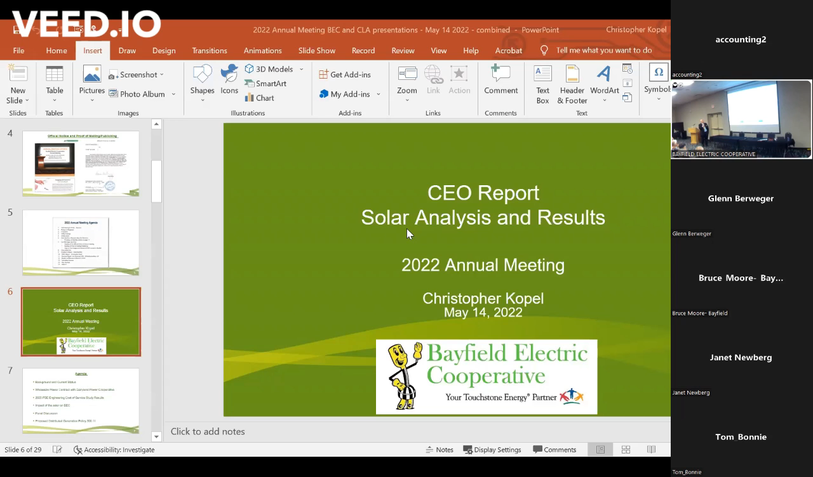
Chris Kopel on BEC Positions

Slide 16
August 2022 Follow-up Meeting
Zoom meeting about proposed DER policy
Posted recording and draft policy on BEC website
Asked for additional member input

Slide 17
October 13, 2022
BEC Board approved new DER policy
Posted final policy, interconnection and net-metering agreement on BEC website

Slide 18
Highlights of New DER Policy
Payback rate for solar put on grid is 100% of retail rate until April 1, 2025
After April 1, 2025, payback rate for solar put on grid is 90% of retail rate
20-year contract guaranteeing 90% payback rate starts April 1, 2025
Any excess over annual usage paid at BEC avoided cost

Slide 19
DER Analysis Tool
Cheq Bay Renewables Open-source Template

Slide 20
Note about Transparency
BEC “Tool” contains economic data (economic participation co-op principle)
Members “own” the cooperative (information co-op principle)
Utilities in WI have monopoly status, not a competitive market
CBR has refined tool as generic template (you supply data)

Slide 21
DER Tool – BEC Analysis
Non-solar members were subsidizing solar members about $0.32 per month ($3.88/year)
  Value of Solar at avoided cost (fuel cost)

Slide 22
Public Benefits Program vs. Solar Impact
 | Public Benefits Program |  |  | Solar Impact
 | 2002 | 2022 | 2022 adjusted for Inflation | 100% Net-metering
Per member per month | $1.33 | $1.31 | $2.19 | $0.32

Slide 23
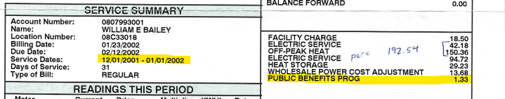
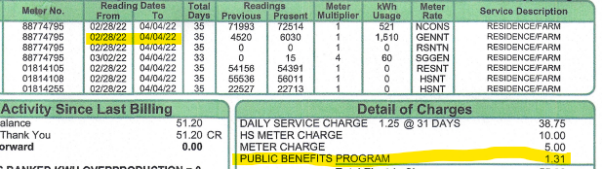
2002
2022

Slide 24
The Value of Solar
 | 100% Net-metering | 90% Net-metering | 90% Net-metering plus Environmental Benefits
Subsidy per member per month | $0.32 | $0.28 | $0.12

Slide 25
About Subsidies
2020 Rate Study showed much larger subsidies between rate classes
It is common for subsidies even within a rate class
  Large users subsidize low users because facility charge doesn’t cover all fixed charges

Slide 26
Subsidy Example
The price of a postage stamp is about twice the BEC solar subsidy
Paperless billing saves the cost of not only a stamp, but the paper and staff time to process
Paperless members are subsidizing members choosing paper billing at about 3-4 times the solar subsidy

Slide 27
BEC Board Reaction
“You mean we have been dealing with all this for two years [and it only amounts to $0.32 per member per month]?”

Slide 28
Tool Benefits
Input Values can be updated, solar impact reviewed, and DER payback rate adjusted as needed
Solar impact is evaluated mathematically, not emotionally or reactively
“Avoided Cost” definition can be adjusted

Slide 29
20-year Contract
Contract payback rate is 90% of retail value which cannot be changed
Board can adjust 90% rate for new solar installations if needed
Contract not transferable
20-year period starts on April 1, 2025

Slide 30
Summary – Documents BEC posted on website during DER development
2 Letters sent to members
Video of annual meeting
Video of follow-up meeting and Presentation
Draft DER policy, interconnection agreement and contract
Timeline of complete DER review process

Slide 31
Also Available:
Timeline summary on Cheq Bay Renewables website
Solar Impact model template upon request:
  cheqbayrenewables@gmail.com

Slide 32
Questions?
www.cheqbayrenewables.org
cheqbayrenewables@gmail.com

